Slide 1





Python库的使用 ——换个姿势读十九大报告
红红火火
恍恍惚惚

Slide 2

项目成员
王立成
田冰凌
崔晓璇
陈洪燕

Slide 3
项目简介
抓取2019年政府工作报告进行分割
01
保存全文分词及出现频率和官方解读链接
02
生成词云
便于分析国家大政方针
03

Slide 4
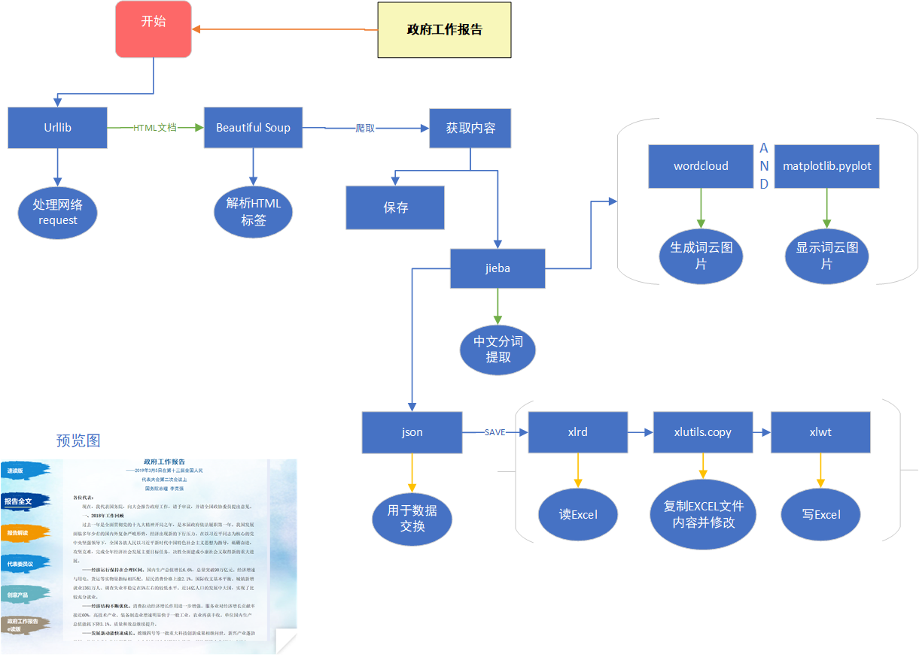
流程

Slide 5
项目内容
导入库
下载网页
抽取网页元素
分词，jieba_fast比较快，但要求安装vs
字典转json
1.请求网页出错时退出 2.保存文件时确定文件是否存在
}
生成词云
预览词云图片
import urllib
import bs4
import jieba
import json
import os
import xlwt
import xlrd
import xlutils.copy
import wordcloud
import matplotlib
读写xls文件

Slide 6
项目内容
程序主体
通过调用其他函数实现子功能，方便修改功能
fontPath = "C:\\Windows\\Fonts\\msyh.ttc"
path = ".\\"
xlsName = "2019 政府工作报告.xls"
url = "http://www.gov.cn/zhuanti/2019qglh/2019lhzfgzbg/index.htm"
try:
html = urllib.request.urlopen(url)
except urllib.error.HTTPError as err:
print(err)
print(url + "\nEXIT!")
os._exit(-1)
soup = str(bs4.BeautifulSoup(html).find(
"div", {"class": "zhj-report-right fr bd"}))
getAll(soup)
getQuickLook(soup)
getInterpretations(soup)
getDiscussions(soup)
getReserved(soup)

Slide 7
项目内容
从网页中抽取报告正文，
调用分词函数和保存文本函数
def getAll(soup):
content = ''
bs = bs4.BeautifulSoup(soup)
paraList = bs.find("div", {"class": "zhj-bbqw"}).find_all("p",
{"style": "text-indent: 2em; font-family: 宋体; font-size: 12pt;"})
for a in paraList:
content = content + '\n' + " " + a.get_text()
splitText(content)
saveText(content, "政府工作报告全文")
Notes:
*声明bs对象
*再用bs里的find()方法获取文本保存到paralist，也就是文本分段列表里
*合并到content
*调用分词函数textSplit()
*保存为“政府工作报告全文”的文本本文档

Slide 8
项目内容
def splitText(content):
dic = {}
splitedText = ""
seqlist = jieba.cut(content)
for word in seqlist:
splitedText = splitedText + word + " "
if word not in dic:
dic[word] = 1
else:
dic[word] += 1
sortedDic = sorted(dic.items(), key=lambda x: x[1], reverse=True)
saveJson(sortedDic, "报告全文")
saveSheet(dic, "报告全文")
wordCloud(splitedText)
使用jieba库进行中文分词
调用saveJson()函数
调用saveSheet()函数
调用wordCloud()函数

Slide 9
项目内容
saveJson()和saveText()将数据保存文件
def saveJson(dic, fileName):
with open(path + fileName + ".json", "w", encoding="utf-8") as f:
json.dump(dic, f, ensure_ascii=False)
def saveText(content, fileName):
with open(path + fileName + ".txt", "w", encoding="utf-8") as f:
f.write(content)

Slide 10
项目内容
使用wordcloud库生成词云图片并借助提供预览
def wordCloud(splitedText):
wc = wordcloud.WordCloud(font_path=fontPath, background_color="white",
max_font_size=200,
max_words=2000, width=3840, height=2160
).generate(splitedText)
matplotlib.pyplot.figure()
matplotlib.pyplot.imshow(wc)
matplotlib.pyplot.axis("off")
matplotlib.pyplot.show()
wc.to_file(path + "词云.jpg")

Slide 11
项目内容
保存表格
def saveSheet(dic, sheetName):
if(os.path.isfile(path+xlsName)):
oldBook = xlrd.open_workbook(path + xlsName)
book = xlutils.copy.copy(oldBook)
else:
book = xlwt.Workbook(encoding="utf-8")
sheet = book.add_sheet(sheetName)
i = 0
for key in dic:
sheet.write(i, 0, key)
sheet.write(i, 1, dic[key])
i += 1
book.save(path + xlsName)

Slide 12

项目内容
def getInterpretations(soup):
dic = {}
bs=bs4.BeautifulSoup(soup).find_all("ul",{"class": "o zhj-bbjd"})[0]
paraList = bs.find_all("a")
for a in paraList:
dic[a.get_text()] = a["href"]
saveJson(dic, "报告解读")
saveSheet(dic, "报告解读")
def getDiscussions(soup):
dic = {}
bs=bs4.BeautifulSoup(soup).find_all("ul",{"class": "o zhjbbjd"})[1]
paraList = bs.find_all("a")
for a in paraList:
dic[a.get_text()] = a["href"]
saveJson(dic, "代表委员议")
saveSheet(dic, "代表委员议")
def getReserved(soup):
dic = {}
bs=bs4.BeautifulSoup(soup).find_all("ul",{"class": "o zhj-bbjd"})[2]
paraList = bs.find_all("a")
for a in paraList:
dic[a.get_text()] = a["href"]
saveJson(dic, "创意产品")
saveSheet(dic, "创意产品")
抓取报告解读链接并保存

Slide 13
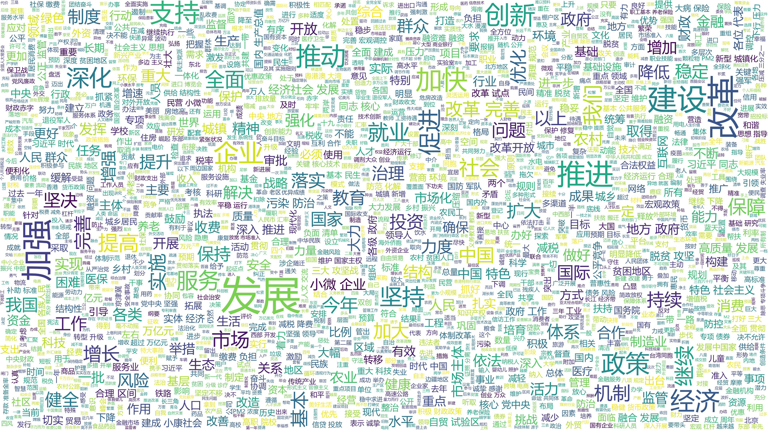
词云

Slide 14
不同平台间的程序移植
对于类Unix平台需要在文件头部添加
#!/usr/bin/env pyhon3
修改字体文件路径变量fontPath
fontPath = “目标路径"

Slide 15
项目总结与反思
?
import datetime
import os
import requests
today = datetime.date.today()
todayStr = str(today)
formatedToday = today.strftime("%Y%m%d")
urlist = []
for i in range(1, 21):
if(i < 10):
order = "0"+str(i)
else:
order = str(i)
urlist.append("http://paper.people.com.cn/rmrb/page/" +
todayStr[:7]+"/"+todayStr[8:]+"/"+order +
"/rmrb"+formatedToday+order+".pdf")
savePath = ".\\RMRB“
if(not os.path.exists(savePath)):
try:
os.makedirs(savePath)
except:
print(savePath+" can not be created!")
for i in urlist:
resp = requests.get(i)
with open(savePath+"\\"+i[-14:], "wb") as pdf:
pdf.write(resp.content)
这次小组项目，将python知识与政府工作报告有机结合起来，解决了实际应用问题。在日后的工作与学习中，我们将进一步学习python语言的有关知识，并运用python语言解决更多实际问题。
比如：下载人民日报

Slide 16
谢谢！
红红火火
恍恍惚惚

